Slide 1
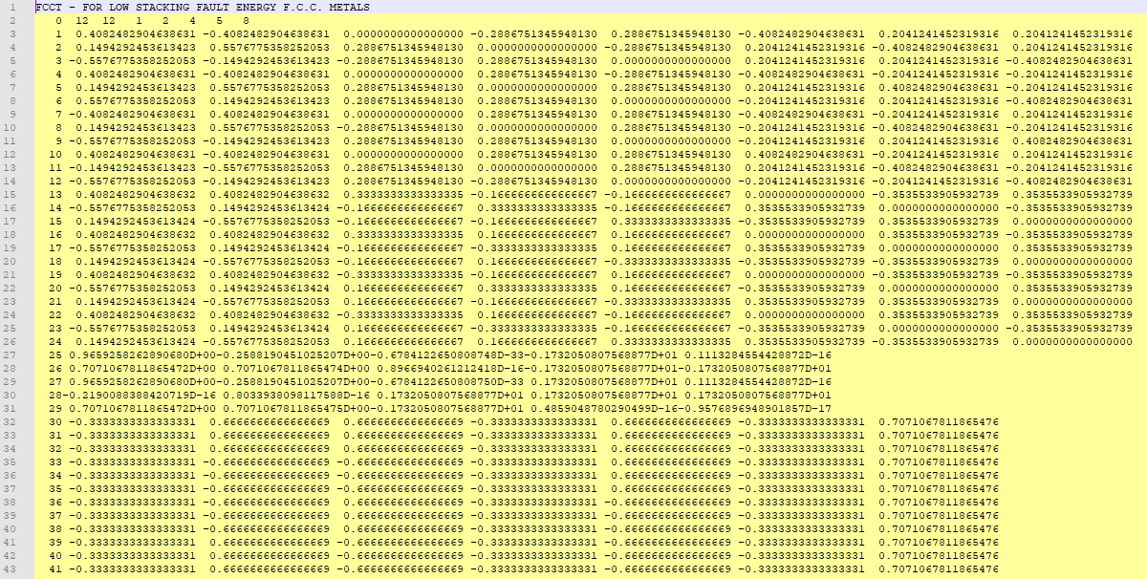
fcct.pre
See subroutine pancak2 and module altayDeformationMechanism for how
these matrices are created and used!
No of twin systems
No of slip systems
Counter
Initial guess of 5 independent
deformation systems
TITglij
NGL NTW DI1 X Y
each row is vector-formatted
symmetric & antisymmetric part of Schmid tensor
(i.e. of normalized velocity gradient);
all deformation systems: first slips, then twins
(A1)^{T}
symmetric part
(5 independent components)
(B1)^{T}
anti-symmetric part
(3 independent components)
(B)^{T}
inverse of the sub-matrix of A1
consisting of the initial guess deformation systems
(B2)^{T}
each row is matrix to calc. orientation of twin
(see subroutine DeformationMechanismData_completeFromDATformat in module altayDeformationMechanism for its definition and Gil Sevillano et al, Progr.Mater.Sci 25 (1980) pp. 69-412, p297 for derivation)
G
twinning shear

Slide 2
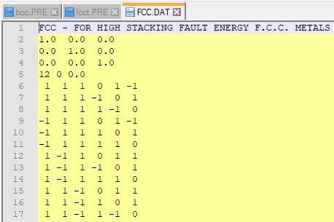
fcc.dat
description/title
unit cell
No. of slip systems
No. of twin systems
plane
Miller indices of deformation systems
(one system per row)
direction

Slide 3
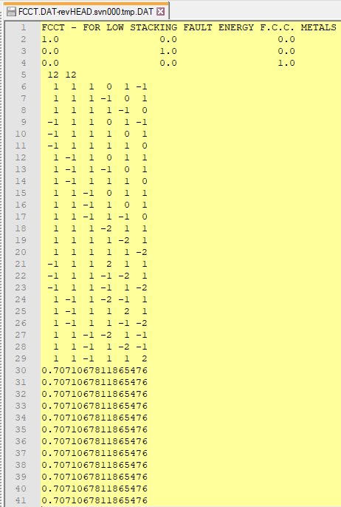
fcct.dat
description/title
unit cell
No. of slip systems
No. of twin systems
direction
plane
Miller indices of deformation systems
(one system per row);
slip systems first, then twin
G
twinning shear

Slide 4
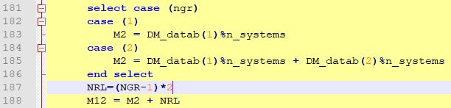
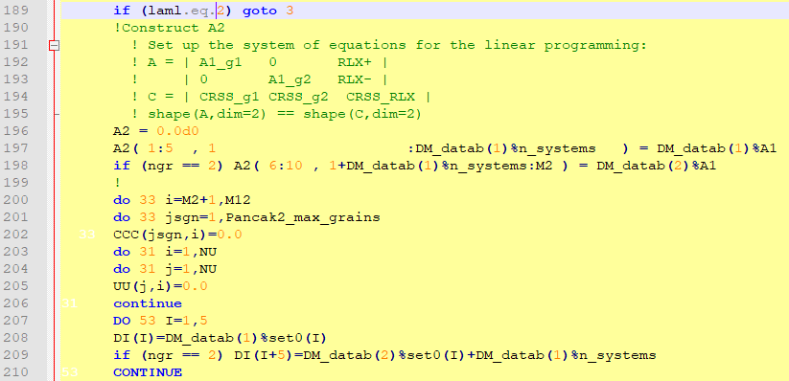


pancak2 subroutine
grain (lamel) index in cluster (1,2 for ALAMEL)
no of grains (lamels) in cluster (2 for ALAMEL)
determine total number of deformation systems, store in M2
case 1: Taylor
case 2: ALAMEL
2 relaxations on each boundary
M12…total number of def. systems + relaxations
do only for 1st grain
see Van Houtte, Microstructures and Texture, 1988, Vols. 8 & 9, pp. 313-350, eq. 29
each column is a basis vector in 5-dim strain space
$$A2=\left[\begin{matrix}Ag1 & 0 & RLXg1 \\ 0 & Ag2 & RLXg2\end{matrix}\right]$$
grain 1
grain 2
Ag1 and Ag2 are [5x5], RLXg1 and RLXg2 are [5x2]
Equation to be solved (Taylor equation):
$$A2∙X=D$$
D…macro strain rate [10x1]
X…vector of slip rates [12x1]

